Slide 1
ASP.NET Core

Slide 2
Models in the MVC Framework
Notes:
Models in the MVC Framework
Introduction
In this chapter, we're going to take a closer look at models in the MVC framework and working with data in general.
We will look at the concept of a view model, both the input and output view models, as well as how to work with the Entity Framework to save our restaurant information into a SQL Server database.

Slide 3
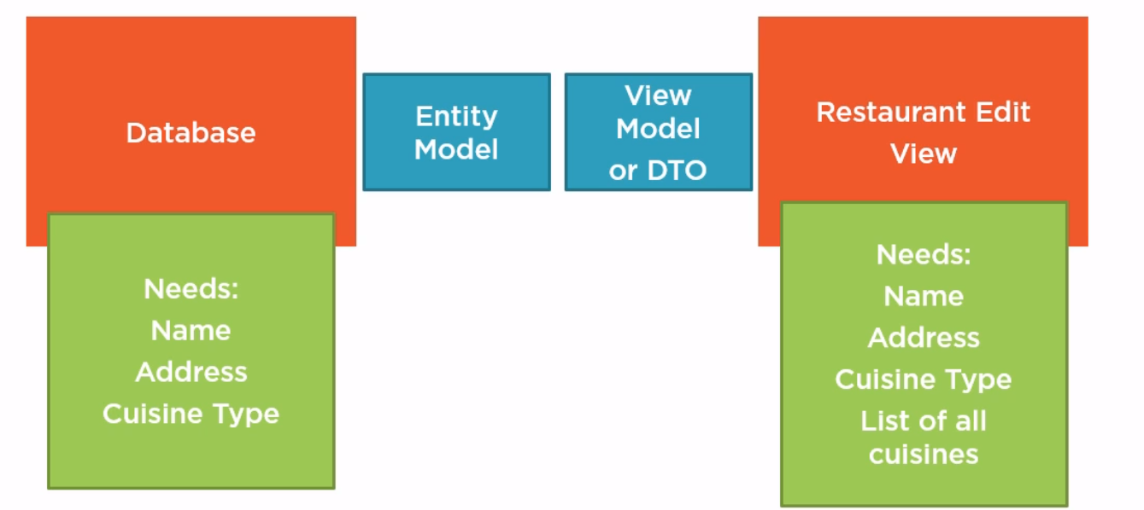
Models and ViewModels
Notes:
Models and ViewModels
Quite often in MVC development, you find yourself in the following situation:
You have an application with a database to store data, and that data could be users, restaurants, movies, invoices, whatever's important to your business.
When you store something like a restaurant in this database, the database will require and store specific pieces of data.
For a restaurant, imagine we're storing the restaurant name, the address, and the type of cuisine that the restaurant serves.
Somewhere else in the application, you might need to build a view to edit the restaurant information that is stored in the database.
The edit view will also have some requirements.
It will need the name of the restaurant, the address, and the cuisine type so that it can display these attributes and allow the user to edit the data.
An edit view typically needs more data than what the database even stores for a restaurant in a single table.
For example, the edit view might want to create a pick list for the cuisine type, and it needs to build this list by fetching all the possible cuisine types that can be stored in the database.
When we query the database for a specific restaurant to edit, we only get the restaurant data with the current cuisine, not a list of all the possible cuisines.
And it's in situations like this where we need two different model objects.
The first model we need is the entity model. An entity is an object that we persist into the database, an entity model typically looks just like your database schema. If the database stores just the name and address for a single restaurant, your restaurant entity also stores just the name and address.
The other type of model object is the ViewModel object. A ViewModel is an object that we use to carry information between a view and a controller. It contains everything that a view will need to render HTML. In the case of an edit view for a restaurant, we need a ViewModel that contains not only information from my restaurant entity with the name, the address, and the cuisine type for a restaurant, but also the additional information that the view needs, like the list of all possible cuisines. Quite often, this requires the controller to make multiple queries and pull back multiple entities to build this view model and put all the information inside that the view needs. That's why sometimes we also call a view model a DTO or data transfer object because this view model carries information around. We don't persist the DTO or save the DTO into a database. We do often copy information into a view model from an entity and from a ViewModel back into the entity so we can save something in the database.
Moving forward, there're two different types of models that we can use in our system.
They serve different requirements.
One is focused on the database.
One is focused on the views.
That can quite often make your application a little bit easier to build.

Slide 4
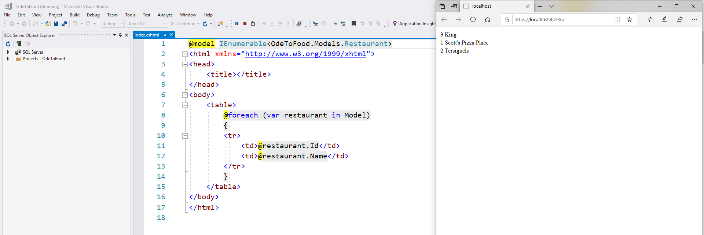
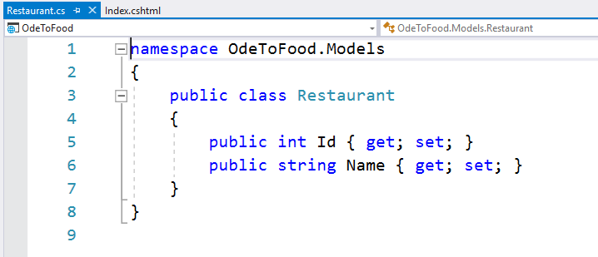
Models and ViewModels
Notes:
Models and ViewModels
Concrete example:
currently in the application, our home page displays a list of restaurants from the restaurant data store.
Let's imagine that the home page needs to display additional information.
Not only do we need the list of restaurants, but we also need to display today's current message.
The restaurants might come from a database, and the message might come from a configuration file.
Regardless of the different data sources involved, what my HomeController needs to do is put together a model that contains all the information that this view needs.
So to pull this off, we do a little bit of refactoring because this Restaurant class is an entity.
It is a class that represents the information we’re going to persist into a database.
It doesn't matter if it's a relational database or a document store. An entity is something we want to persist.
In the view, although we can still use restaurant data right from that restaurant information in our model, it can no longer be just a simple collection of restaurants.

Slide 5
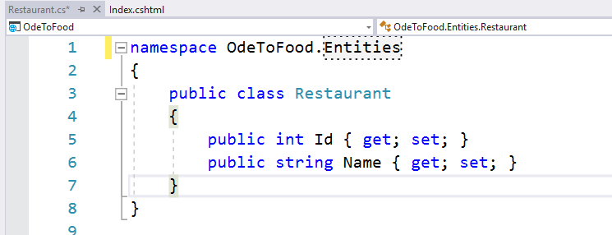
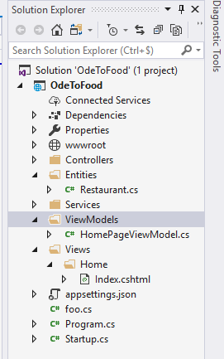
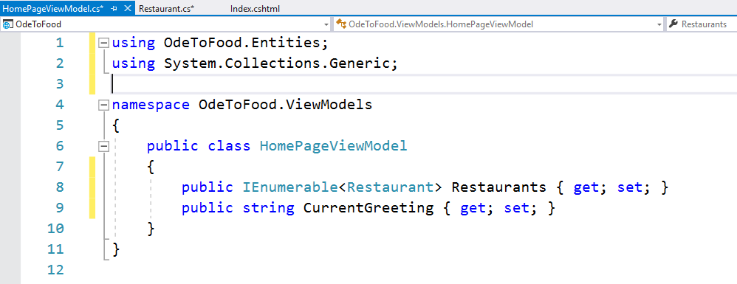
Models and ViewModels
Notes:
Models and ViewModels
The first thing we’re going to do is to change the folder name (that is currently Models) to Entities.
We’re going to close Restaurant.cs and reopen this file because sometimes Visual Studio acts a little bit funny when you rename a folder.
The editor doesn't like to work on the files that are inside.
When we reopen it, we also to change the namespace because the convention in .NET asks that the namespace and the directory structure are in sync.
The Restaurant class is in the Entities folder, it's in the Entities namespace.
We create a new folder ViewModels.
Not every application needs to make a distinction between entities and ViewModels.
There are many simple applications and simple controllers you can write where your entities are your ViewModels.
More complex application do need to make this distinction between classes that store data and classes that carry information into your views.
The ViewModel is a ViewModel that is dedicated to the home page.
It will contain the list of restaurants and it will contain the current greeting.
We call it HomePageViewModel.
This class will need to carry along a list of the restaurants into the Index view, we work with IEnumerable<Restaurant>.
We use our Entity class (Restaurant) inside of the ViewModel.
That's not always something you can get away with either, but we’re trying to simplify just a few things in this course.
We will call this property Restaurants.
We also need a property to carry the current greeting along. We add a string property named CurrentGreeting.

Slide 6
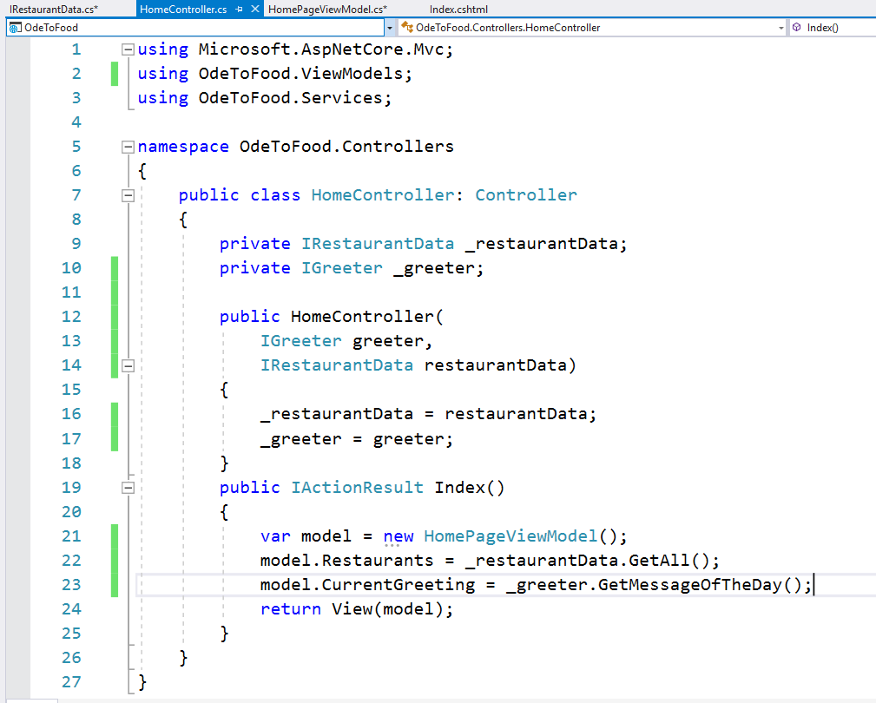
Models and ViewModels
Notes:
Models and ViewModels
Our controller (we change the Models namespace to ViewModels because we're going to be using the HomePageViewModel), and we will be using a new instance of the ViewModel instead of just using restaurantData.GetAll() as the model.
model.CurrentGreeting, we will get this from the greeter service.
We fix up a few more things.
_restaurantData.GetAll() is currently complaining because we've changed the namespace for Restaurant, so the compiler doesn't know where to find it.
This has to be OdeToFood.Entities.
How do we get the current greeting?
Just like we injected IRestaurantData, we can also inject our IGreeter. We'll call the parameter “greeter”, and we will also save that off into a private field. It is now part of our controller.
The controller has constructed the view model using a few lines of code and a couple of different services. It's going to take that model and pass it off to the Index view.

Slide 7
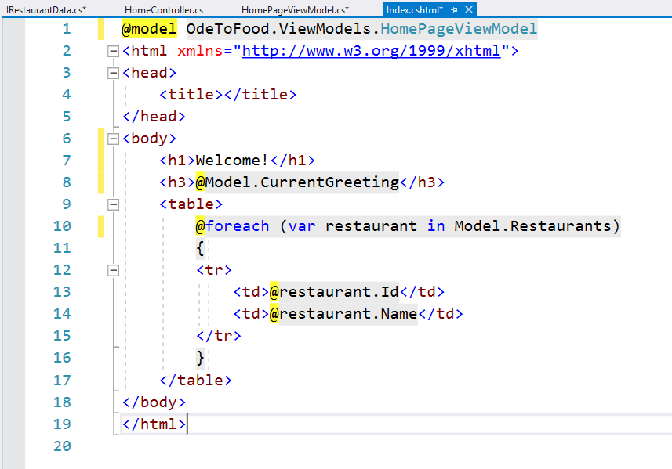
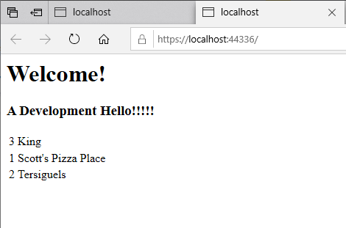
Models and ViewModels
Notes:
Models and ViewModels
Let's fix up the Index view.
We're no longer working with an IEnumerable<Restaurant>.
Instead we are working with an OdeToFood.ViewModels.HomePageViewModel.
That will be the type of our model property. Under the h1, let's add in a h3 element that displays the current greeting.
To display the restaurants, we need to drill into Model.Restaurants. That will give us our IEnumerable of Restaurant.
We now have a view that displays both a message and the list of restaurants.
So in the world of ASP. NET MVC, there're actually a few different ways that you can get information from a controller into a view.
We recommend that you build view models for your views and have those ViewModel classes contain all the information that you need to shuttle from the controller into the view.
This has been a very simple demonstration of that technique, but you can extrapolate this out to ViewModels that are very complex.

Slide 8
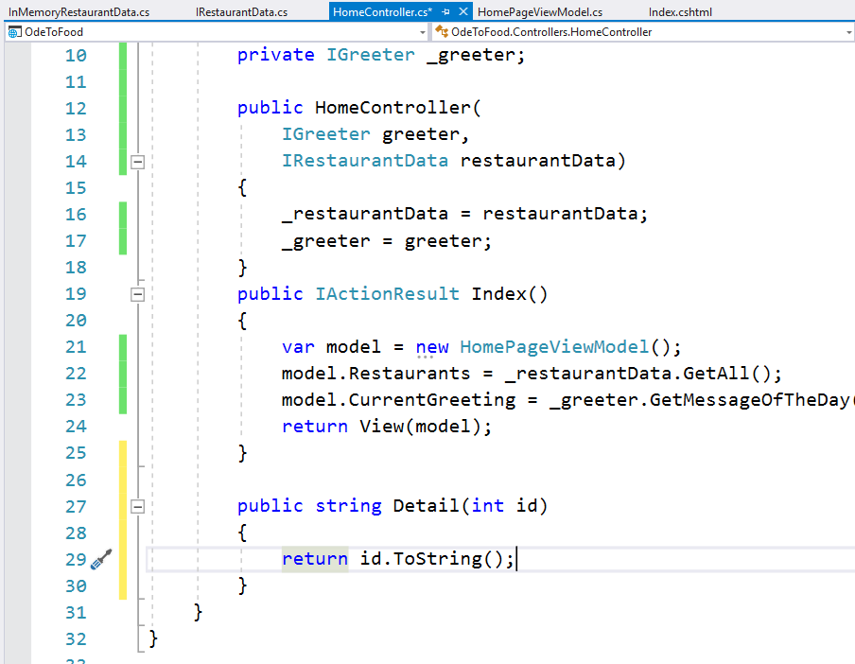
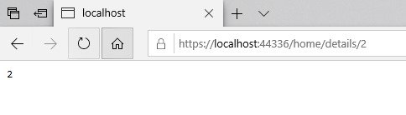
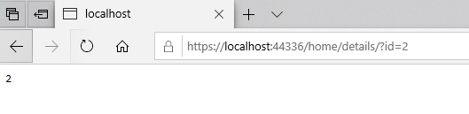
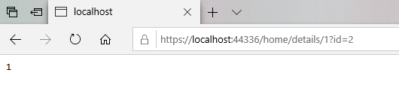
Detail a Restaurant
Notes:
Detail a Restaurant
Let’s have a look at models that are used as inputs to a controller action.
Imagine that we want to give the user the ability to see the details for a specific restaurant, so not a list of all the restaurants.
They just want to see a specific restaurant. If that's the case, we probably need to add another action to our controller, one that can return a ViewResult that shows just a single restaurant.
What can we use to identify a restaurant? We plan on the Id property being a unique primary key in the database.
It would make sense for the Details action to take an integer Id parameter and then look up the restaurant using that Id.
Anytime we have a parameter on an action, we consider that to be a type of model, an input model.
And even though an integer is a simple primitive type in C#, with ASP. NET MVC, we do have the abilities to take complex input models.
For example, we could have a restaurant as an input parameter (public string Details (Restaurant restaurant)).
For details, all we need is a simple integer.
Where does this integer Id come from?
For right now, let's just return a string, and we'll just return id.ToString(). That'll show us the Id that we receive.
If we run and go to /home/details/2, our details action receives an Id parameter equal to 2.
How does the MVC framework do this?
When you have an input parameter to an action method, the MVC framework will do everything in its power to populate that parameter, and it will look around in the request environment to find something with the same name as this parameter.
We named the parameter id.
ASP.NET MVC is looking for something named id. In this case, when the parameter appears in the URL, it is actually our routing rules that allow this to happen because we said if you see
/controllername/actionname/<a third piece of the URL>, then treat that third piece as an id parameter.
It's optional. It doesn't have to be there. But when it is, MVC will take the information contained in that segment of the URL and give it the name of id.
When we have an input parameter, the MVC framework looks around in the request environment.
It looks at things like the routing data that was generated from the URL.
It also looks at query strings.
It also looks at posted form data.
If we come out to the browser and we remove the 2 from here, we could also go to /home/details/?id=2, and receive the parameter 2.
Earlier we were telling you quite often you don't need to go into the HttpContext property and look at the request object to find something in the query string of the URL.
The MVC framework can actually identify data that is in the request and hand it off to you.
You're probably wondering, what happens if we go to /home/details/1 and then use a query string id=2, well in this particular situation, the MVC framework favors the id that was found in route data over the id that was found in the query string.
That's just an implicit default in the framework.

Slide 9
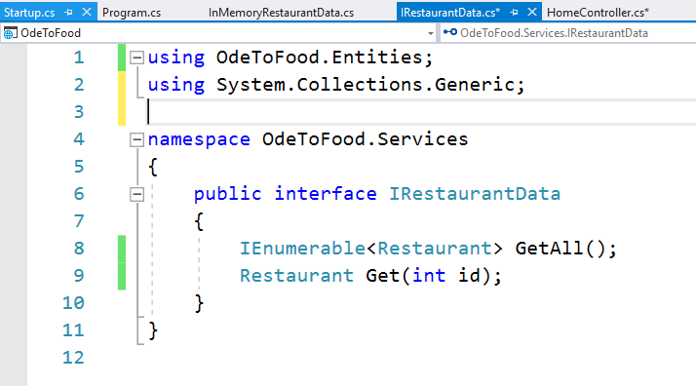
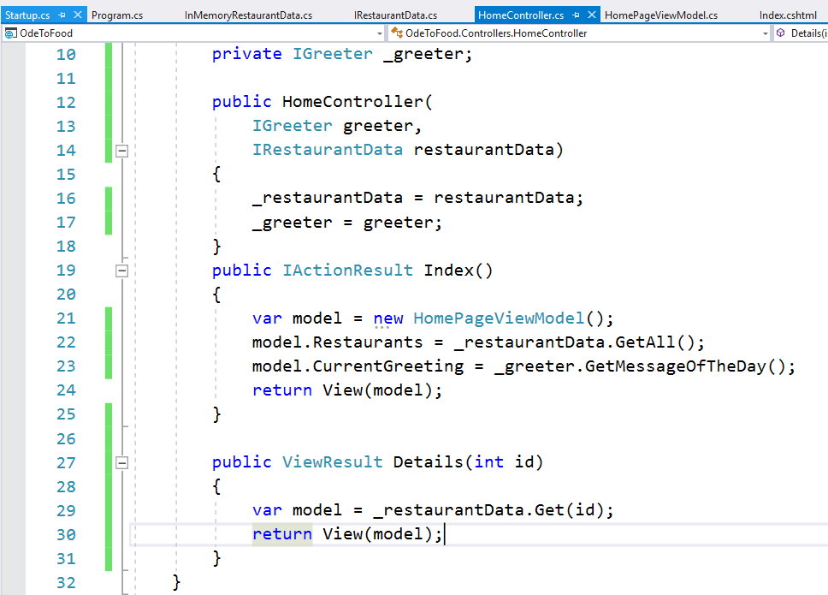
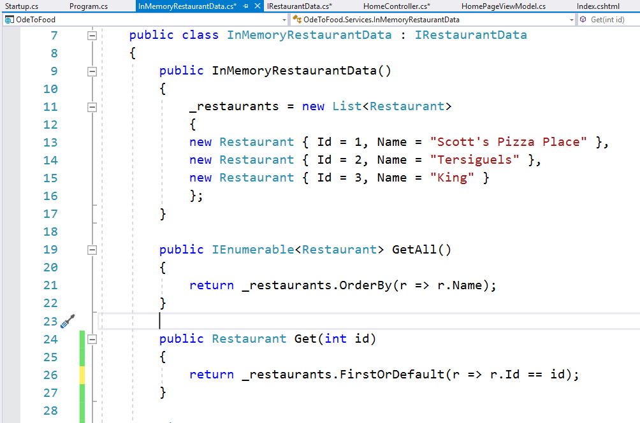
Detail a Restaurant
Notes:
Detail a Restaurant
Now let's go to the business of actually finding the restaurant with this id and returning some sort of result that will display details.
In this scenario, our model, we’re just going to pull out a restaurant from _restaurantData, and that restaurant entity will be our model just to simplify this scenario.
We’re going to need a new method on our _restaurantData service that will allow us to get a single restaurant given the id.
Over in RestaurantData, for the interface definition, we have to add a method Get() that takes an integer and returns a restaurant.
We have to implement that member in our InMemoryRestaurantData, a public method that returns a restaurant that's called Get() that takes an id parameter.
We can just use a simple LINQ query to locate the restaurant in the list.
If we are using System.Linq to pull in all of the LINQ standard operators, we'll be able to use _restaurants.FirstOrDefault(), which means LINQ will evaluate the following expression, and the first thing it finds that matches, it will return that.
Otherwise, it will return the default value for restaurant, which is a null reference.
The expression that we'll use, a lambda expression (r for restaurant). _restaurants.FirstOrDefault(r => r.Id == id).
Let's save RestaurantData, come back to our controller, and let's assume for right now that we always find the restaurant.
We’re just going to return a View with that model and save the controller.
We just need a Details view.

Slide 10
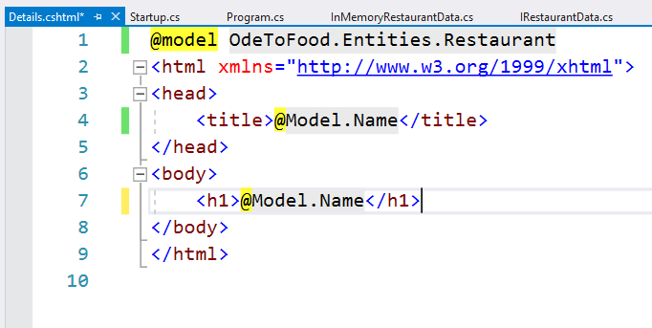
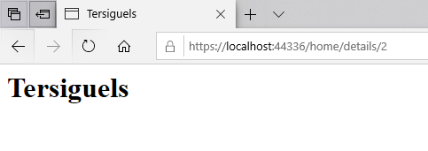
Detail a Restaurant
Notes:
Detail a Restaurant
We make a copy of Index.cshtml, change the name of this cshtml file to Details.cshtml..
First of all, we will change the model.
We expect the controller to pass a Restaurant entity.
Let's change the title of the page to use the restaurant name.
The only interesting attributes we have are name and Id, and the user probably doesn't care about the Id, so let's just write out the restaurant name in an h1 element.
We'll add some more attributes to our restaurant later on.
Let's test this out in the browser:
let's go to /home/details/2, and we can see that is Tersiguel's, so I'm pulling back just a single restaurant displaying that in a view.

Slide 11
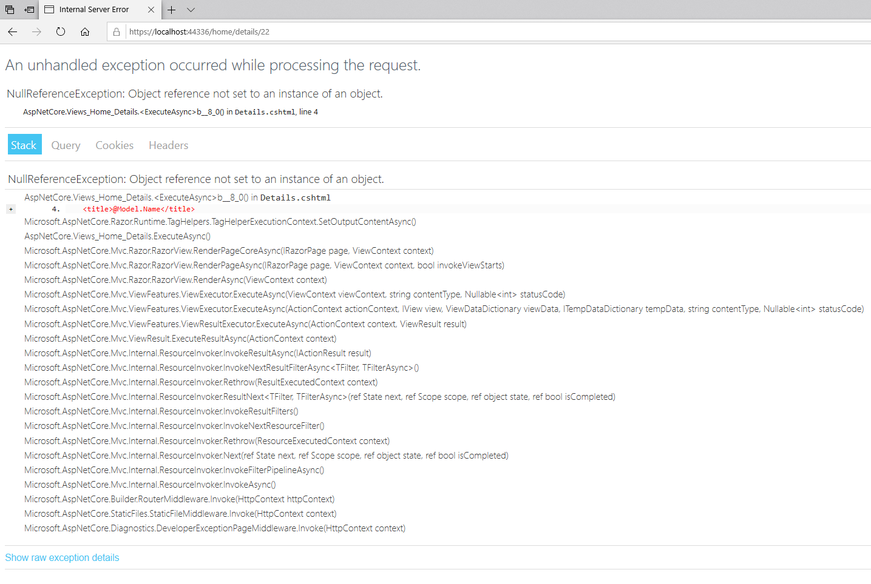
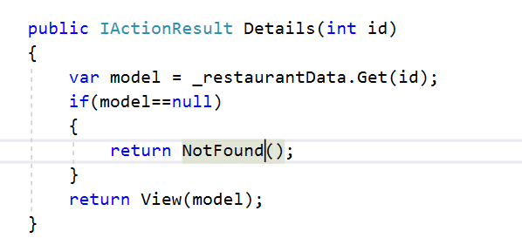
Detail a Restaurant
Notes:
Detail a Restaurant
What happens if we go to /22?
Our RestaurantData returns a null pointer.
It didn't find a restaurant with that Id.
Because the view expects Model not to be null, and we de-reference Model and use @Model.Name, this is throwing an exception because the Model property is null.
What can we do in this situation? There're a number of different solutions.
One thing we could do is to test if the model is null and then do something different. We could, for instance, return NotFound(). What that would do is set the response status code to 404 Not Found. In order for that to work since we now have two different types of results that we can return, this is one of those scenarios where we can say this method returns an IActionResult.
This would be one approach.

Slide 12
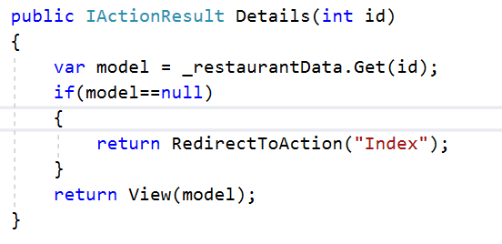
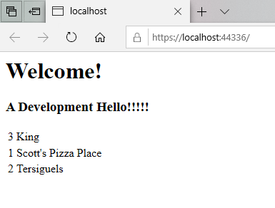
Detail a Restaurant
Notes:
Detail a Restaurant
We could also redirect the user.
There are helper methods available in the controller action that allow us to do temporary redirects of permanent redirects.
In this case, we want to redirect to an action.
For example, if the restaurant isn't found, we’re just going to send the user over to the page that displays all the restaurants, and we can specify the action to go to as a string.
There's a different overloads to this method where you can also specify the action on a different controller, but since we're just going to go to the same controller, all we need to do is specify just the action name.
When we run, the request for /home/details/<some id that doesn't exist> brings us back to the home page.

Slide 13
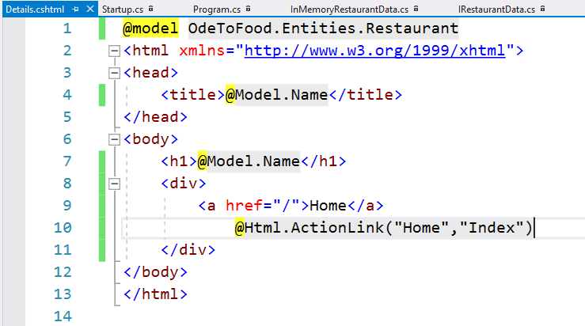
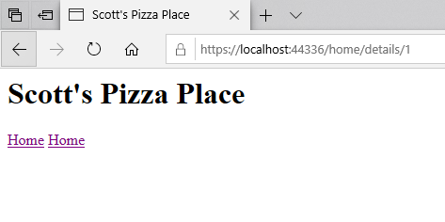
Detail a Restaurant
Notes:
Detail a Restaurant
It also might be nice if there was a link on this view that would take us back to the list.
Some navigational links that work with the routing rules that we have defined.
There're a couple of different ways to do this.
Essentially what we need is an anchor tag with an href that points to /home/index, or since that's the default route just the root of the website, and we can have it display the text Home. That link would certainly work.
There're also situations where you want to generate a link in a way that works with your routing configuration.
That's where another property, the Html property comes into play.
The Html property is an instance of an IHtmlHelper. It contains a number of methods that allow you to generate little snippets of HTML.
It's all HTML that you could write by hand. But typically, an HTML helper has some additional logic behind the scenes to use some metadata or to use some configuration information that's available in your application.
One example of this is the HTML helper ActionLink.
Essentially, ActionLink will build an anchor tag, but when it computes the href, it will use some information that you provide to figure out what the correct URL is.
ActionLink is going to be a link to some controller action.
The first parameter we pass in is the text that we want to display. We want to display the text Home.
The second parameter to pass in is the action that we want to reach with this URL.
If you don't specify a controller name, it just assumes you want to go to this action on the controller that rendered this view.
This would be the Index action of the HomeController since this is rendered by the HomeController's Details action.
Intellisense tells us there're many different overloads of ActionLink that allow you to specify things like a different controller to go to.
But this is all we need to get a Home link back to the list of restaurants.
These are two ways to do this. we will show you a third technique in the next chapter. It's a very useful new technique for this version of MVC.

Slide 14
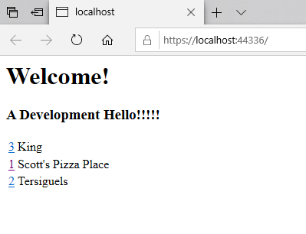
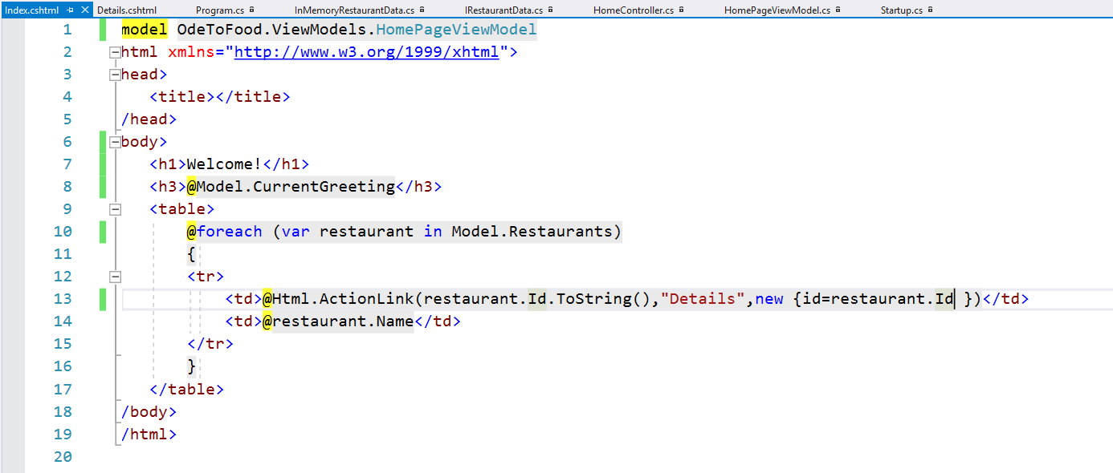
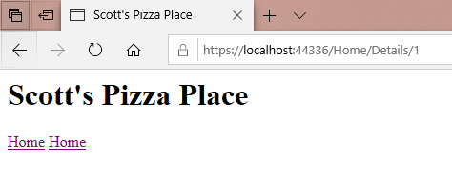
Detail a Restaurant
Notes:
Detail a Restaurant
When we are on this list of restaurants, we would like to have a link to go to the details.
This is where we can use ActionLink again.
In the Index view, instead of displaying just the Id, we want the Id to be in a link that will take us to the details.
We want to use @Html.ActionLink.
What is the text that we want to display? Let’s just use the restaurant Id again.
Only we will make sure that this is passed as a string, that's my linkText. when the user clicks on this, what action do we want them to go to?
We want them to go to the Details action. And because Details has this extra parameter, this Id that has to be passed along, we need to tell ActionLink about this additional data.
That's the purpose of this routeValues parameter.
Essentially, what you can do with routeValues is pass in an anonymously typed object, which sometimes Visual Studio will fight you trying to create that anonymously typed object, but we want a new object.
And then I give this object properties for the data that needs to be passed along. And the names are significant. If we want a piece of data plugged into the Id portion of the URL, then we need to create a property called Id and then just give it the value like restaurant.Id.
Then ActionLink will look at this information and see you want to go to the HomeController because we didn't specify a controller here, and more specifically the Details action, and you want to pass along an Id parameter.
Let’s talk to the routing engine and figure out what that URL should be.
If I save Index.cshtml and refresh the page we now have links. We can see that this link in Chrome is for /Home/Details/3. That perfectly takes us to the Details page. This Id parameter in the URL, we kind of think of it as an input model.
You can have more complex input models, and when we want to create an entire restaurant, we'll need more complex input models.

Slide 15
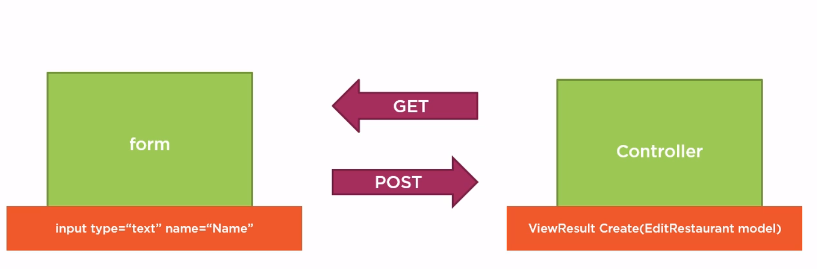
Create a Restaurant
Notes:
Create a Restaurant
What we want to do next is see how to create a new restaurant.
With HTML, anytime you want to give the user the ability to enter data into a page, you use an HTML form element.
How will we build this form?
Like everything else with ASP.NET MVC, we will have an HTTP GET request that goes to a controller, and this controller action will return a view that includes the form.
To create a restaurant or edit an existing restaurant, we'll need an action that returns HTML with the form inside.
Inside this form, we'll have input elements to enter text and numbers.
We might have checkboxes and dropdown lists and sliders. There's a variety of input controls.
We'll need this controls to have a name so that MVC knows how to process the incoming data when it comes back to the server.
Ultimately this form needs to use an HTTP POST operation to send the form data back to the server where we can process the incoming POST with another controller action.
We'll see how MVC can map incoming form values from our inputs into a model object that is a parameter to our controller action as long as we follow some easy naming conventions.

Slide 16
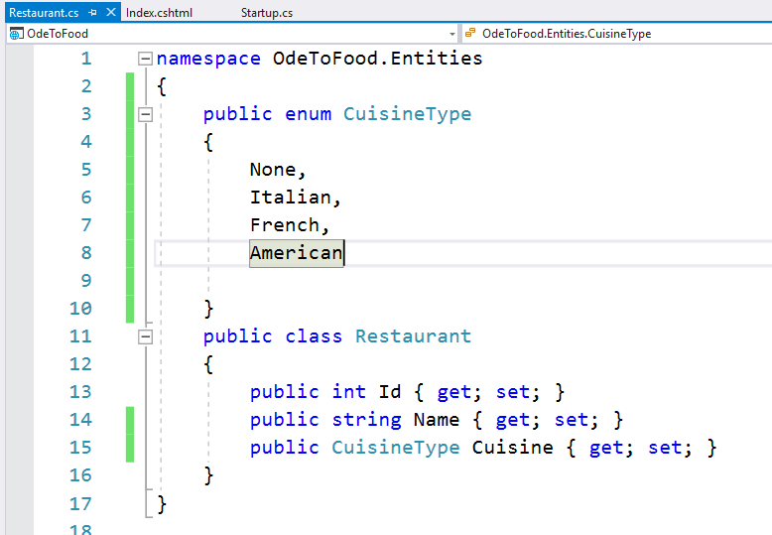
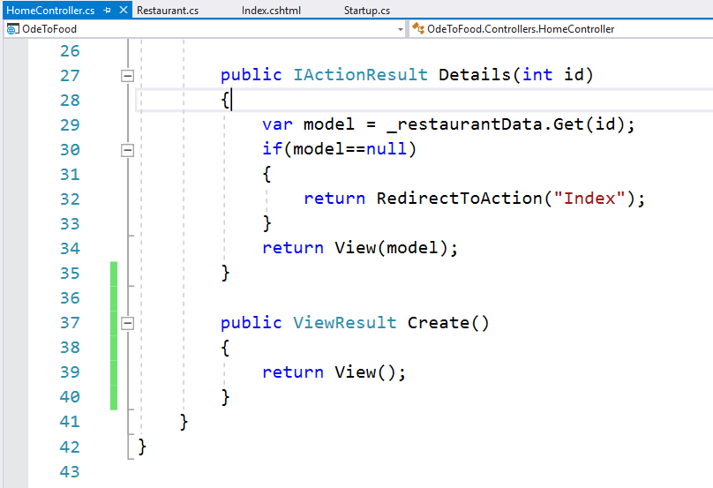
Create a Restaurant
Notes:
Create a Restaurant
Let's make this creation scenario just a little more interesting by adding some additional attributes to our restaurant.
Actually, we just want to add one more attribute.
But to make it more interesting than a simple type like string or integer, let's add an enum property to our restaurant.
We want to be able to store the type of Cuisine that a restaurant serves. There will be a property on a restaurant of type CuisineType that we call Cuisine.
The types of Cuisine would include None, that will be the default value, that's if we don't know the cuisine type of the restaurant. Let's also add Italian, French, and perhaps American.
We save this restaurant definition, and need a form now that will allow a user to input the name of the restaurant and the type of cuisine that restaurant serves.
In order to build that form, we will need the browser to visit a controller action.
We create an action with the name of Create.
Let's just have this action return a view.
Since we’re creating a restaurant from scratch, we don't have a model object to give this view, although there are many scenarios that will require a model quite often when you are creating something.
You'll need to provide some information on that page that allows the user to pick from a number of different options.
Perhaps you have some default values for some fields.
Those are the types of situations where you can build and edit ViewModel and populate that model with information that the view needs to display the correct form.
Our scenario's a little bit simpler. And even though the user's going to have to pick the type of cuisine, We'll show that we have enough information to do that.
All we need is a Create.cshtml view.

Slide 17
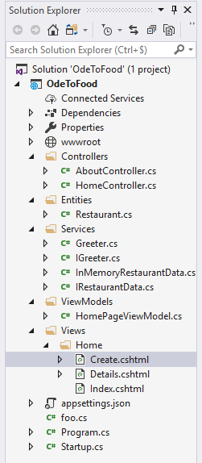
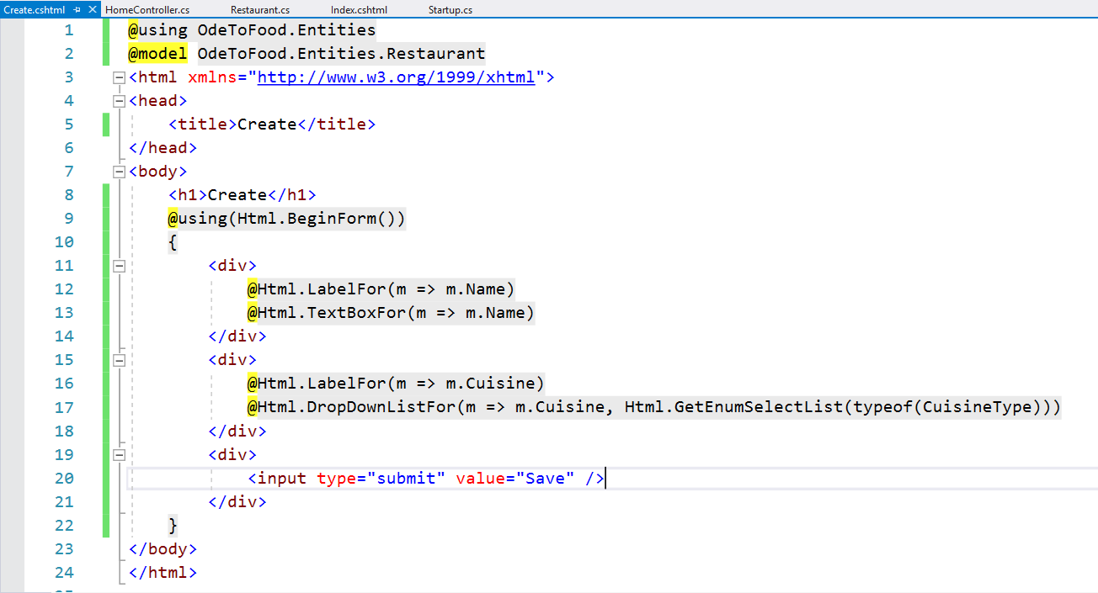
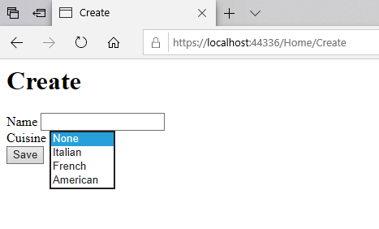
Create a Restaurant
Notes:
Create a Restaurant
We make a copy of the Details view and call it Create.cshtml.
Since we are creating a restaurant, we don't have a restaurant name to put in the title. Let's just use the text Create.
Let’s also use that tekst at the top header for the page.
What we need to do is build a form.
Once again, we can build forms, and we can build inputs just writing HTML.
But we will use HTML helpers to achieve this same effect because the HTML helpers know about the built-in conventions in the MVC framework.
When we follow the conventions, we typically write a lot less code.
We’re going to use the HTML helpers, but we'll show you the HTML that they produce once we have this form implemented.
The first helper we’re going to use is a helper called BeginForm.
This helper is a little bit odd because you actually can wrap it in a using statement because this particular helper returns an object that implements IDisposable in C#.
The way this helper works is when you call BeginForm, it will basically write out the opening form tag at that point.
At the bottom, when the generated code calls dispose on that object, that's when it will write out the trailing form.
So BeginForm gives us an object that will write out our opening form tag and our closing form tag.
We can just focus on labels and inputs.
This will not be the prettiest user interface. There're lots of videos and articles about styling forms. We're just going to focus on the ASP.NET MVC part of this.
What we need is to present a user interface so that the user can enter the name of the restaurant and select the cuisine of the restaurant.
Once again, we could use raw HTML. We could build an input element ourself. But we’re going to use an HTML helper for the name of the restaurant.
This HTML helper is TextBoxFor. This builds an input type equals text. It does this by using metadata about the model object that you're working with.
What we have to pass into this helper is a lambda expression that tells the HTML helper which property of the model do we want you to work with.
So we have to pass in a lambda expression that takes one parameter. This parameter always has the same type as the model object.
m is a restaurant, but we’re using m for model.
Given a model object m, we want you to look at the name of the restaurant.
Although we’re nog passing in a model object into this view, what this HTML helper is doing is really looking at metadata about this property, what is its name, what is its type, and then building the appropriate HTML.
If we were editing a restaurant instead of creating a restaurant, we would pass in a model object.
And what TextBoxFor would do is build an input element whose value is equal to the name of the restaurant.
So getting an existing restaurant's name into the form, that would be taken care of for me.
There's also an HTML helper that will build a label for this input. And it also uses a lambda expression.
Given a model object m, we want you to build a label for the name input.
Let's allow the user to select the cuisine type. We build a label for that.
So given a model object m, which is of type restaurant, we want a label for cuisine.
We’re going to use an HTML helper, which is DropDownListFor. This essentially builds a select element with a number of options.
Once again, we have to pass a lambda expression that says this is going to be setting the cuisine of the model object.
Again, if we were editing a restaurant, that would set the initial value of this drop-down list to the value that is in the restaurant.
Then this HTML helper needs some additional information. It's going to need a collection of SelectListItems, which is essentially what are the available options in this drop-down list.
That's one of those pieces of information where sometimes you need to build an edit view model to pass into this view so it can build all of the pick lists for a user.
If you are using an enum type, sometimes you can get away with using another HTML helper, which is GetEnumSelectList.
Essentially what this method will do is look at an enum type and use the names that are in that enum to build a list of select items, which are then used to build the drop-down list.
What we have to specify is the type of the enum that we’re looking for, and we’re going to use typeof(CuisineType).
We'll have a little bit of a problem here because inside of Razor, the generated code doesn't know what CuisineType is.
We either have to fully specify the namespace, or we have to add a using directive.
Just like in a C# code file, we can have using statements that make the types inside of a namespace available.
We can do the same thing in Razor with a using directive.
We add using OdeToFood.Entities. We don't have to specify the namespace in the model directive.
That type will be available. Also CuisineType will be available. So everything in that namespace is now available.
The last piece of UI that we would need is a button that the user can click to send this information back to the web server.
We’re going to have an input type="submit" whose value="Save".
We save all the files, come back to the browser, refresh, and we now have the ability to input a restaurant name and also select a cuisine type and then press Save.

Slide 18
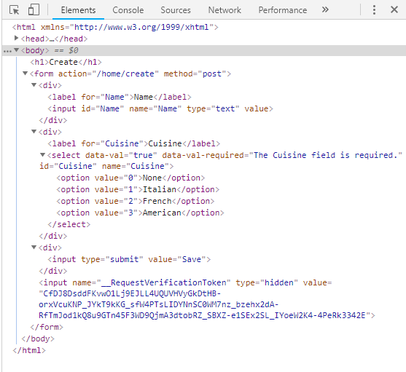
Create a Restaurant
Notes:
Create a Restaurant
Let's just look at the HTML that was generated.
When we look at the the page source, we can see that the BeginForm helper created a form tag.
The action for that form tag points back to the action that we came from, so /home/create.
When we click the Save button, what this form will do is an HTTP POST back to the web server.
We use an HTTP GET to retrieve this form.
We’re doing an HTTP POST to send this form back to the server.
Then we have our cuisine types inside of a select.
We have an input for the name. Notice the name attribute of this HTML element was set to Name. That's a very important convention.
We'll see how that works in the next part. For now we just want you to know if we were editing an existing restaurant, the view would almost look identical.
The only additional piece of information we would have to store is the Id of the restaurant that we're editing so we can send that back and the server knows which restaurant we're editing.
We could store that inside of a form. That's typically done with something like the hidden fields, so input type equals hidden.
That way the user doesn't see the Id on the screen.
Typically, they don't care about the Id. But we'd still have that piece of state inside of our form to send back to the server so it knows what restaurant that we're editing.

Slide 19
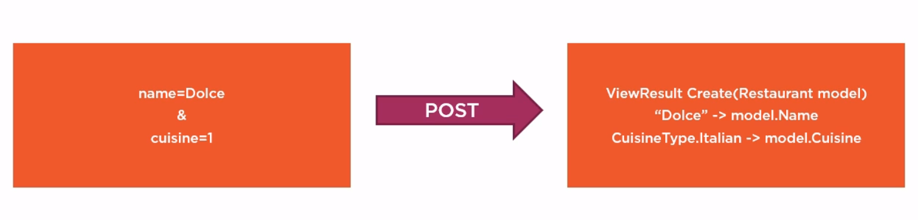
Form to Models
Notes:
Form to Models
We are ready to post our restaurant to the web server, and this will reach a controller action that has an input model as a parameter to the action.
The MVC framework does everything it can to populate your action parameters based on information in the HTTP request environment.
Like earlier we took an Id to the Details action, and MVC populated the Id parameter with the Id from the route data. It also worked when the Id was in the query string.
For complex input types like a restaurant type, MVC will look at the properties on the type and map route data, query string, and form data into these properties.
If we post a form with name and cuisine in the form data, MVC will automatically map those values into their respective properties by name on the input model.
If a restaurant has a name, it will receive the name value from the posted form values.
You have to be very careful when selecting an input model because MVC will, by default, try to set all the properties, and you can never, never trust data coming over the network.
We'll talk about that more later and see how it works.

Slide 20
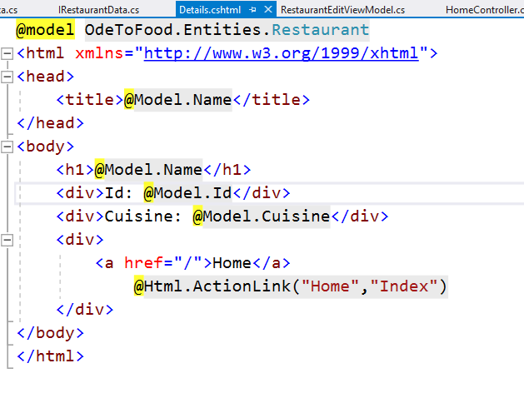
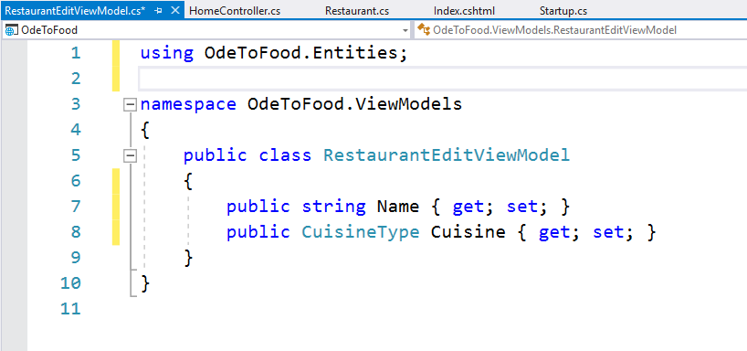
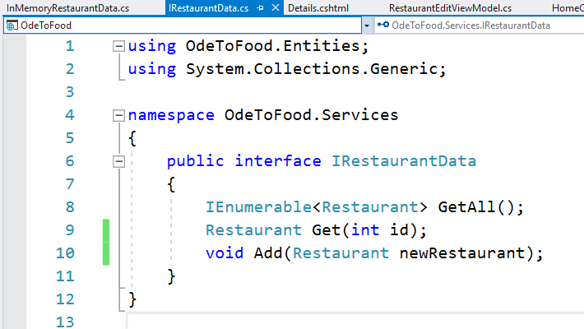
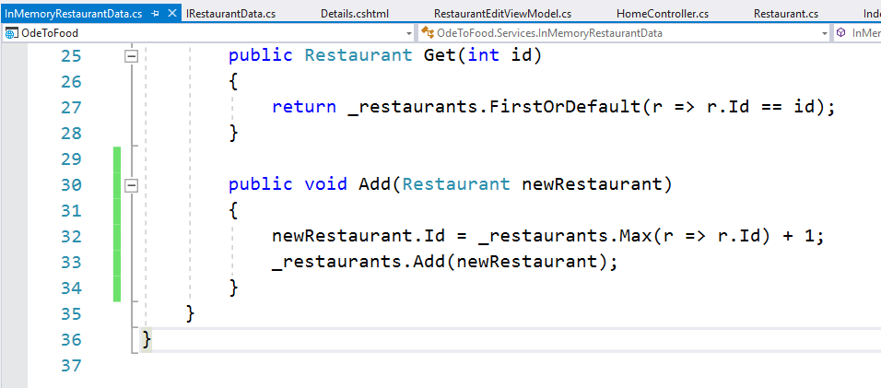
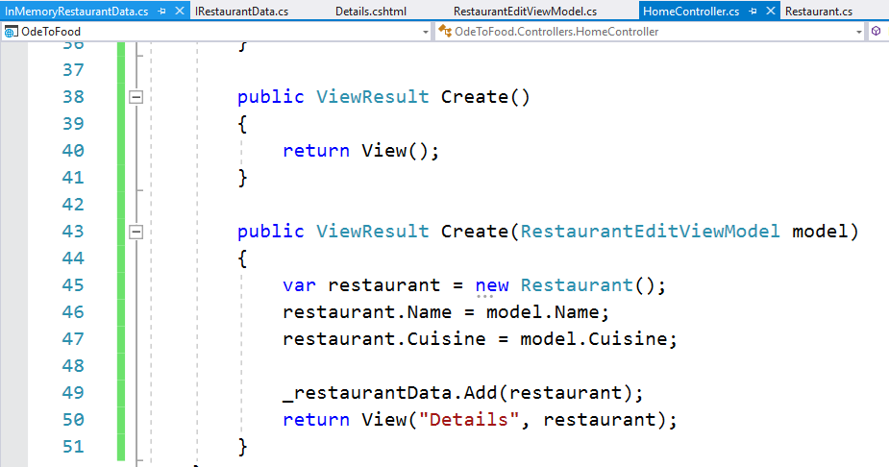
Form to Models
Details.cshtml
Notes:
Form to Models
To process our posted form values, we open the HomeController. Based on the HTML that we looked at that this form is going to post back to /home/create.
There are parameters that we can pass to BeginForm to tell it to behave differently, for example, to do a GET request instead of a POST request or go to a different controller or a different action.
We’re going to let it come to /home/create, and we’re going to create a different version of the Create action to receive the posted form values.
We could use Restaurant as our input model and we are going to bring in the namespace OdeToFood.Entities, but there are several downsides to this.
We do not know what data we’re going to receive over the network.
If our restaurant has any properties or any attributes that we don't want network data to get into, then we are much better off not using an entity but using an input view model.
Instead of taking a restaurant, which would work, we’re going to create a new input view model by adding a class to the ViewModels folder.
We call this RestaurantEditViewModel. We could use this class for creating a restaurant or editing an existing restaurant.
The most important thing here is that if we are creating a text box for the restaurant Name input, that will create an input with a name of Name.
And in order to receive that input, we will need a property on our input model that has the same name as that field.
So the name is Name and we can also have a property to accept the cuisine type we'll need to bring in the namespace OdeToFood.Entities.
But the name for this property will be Cuisine.
And even though we’re working with a restaurant model on one end, on the outgoing end, we can still using this edit view model to receive inputs from the form.
In all but the simplest scenarios, that is what we would suggest just so you don't open up any security holes.
This view model will contain only the properties that I expect to receive in the HTTP request.
In the controller with this new Create action, we will take a RestaurantEditViewModel as our model.
We're not doing any validation yet, but we just wanted to set up the simplest scenario for seeing if we have retrieved the correct information.
Let’s create a new restaurant out of this model information.
In the controller action itself, we will create a new restaurant, and we will map fields from the input ViewModel into our restaurant.
This is a little more work than just using a restaurant itself as the action parameter, but it is safer.
The restaurant.Cuisine would equal model.Cuisine.
At this point, we want to be able to walk up to our restaurant data and tell it to add this new restaurant.
Just to see if we get the correct results, for right now, we’re going to return a View result.
We’re going to explicitly return the Details view and pass in the restaurant.
We just want the Details view to dump out what information we have on the restaurant.
Over in Details.cshtml, we're already displaying the restaurant name.
Let's also display the restaurant Id so we can see if the Id gets generated.
We would expect most data sources to be able to automatically populate the Id of this new restaurant with a unique identifier.
In the Details view see if we get the correct cuisine, so add @Model.Cuisine.
Let's just add a little bit of text so we know what we're looking at.
We’re displaying the Id and the cuisine. We just want to see if we can get the input values into our model, copy these values into a new restaurant, and save it into our data source.
There're a couple more changes we'll have to make later, but for right now, what we have to do to get this working is have an Add method on RestaurantData.
So let me go to our Services and have a method called Add that takes a new restaurant, and implement this in our InMemoryRestaurantData.
We want this data source to compute a new Id for this restaurant.
One way we can do that is by looking at our existing restaurants and using a link query to say, give us the maximum Id that you see in the existing restaurants, and then we'll add 1.
So newRestaurant.Id = that computed Id.
Then we can go ahead and save this new restaurant into our collection.

Slide 21
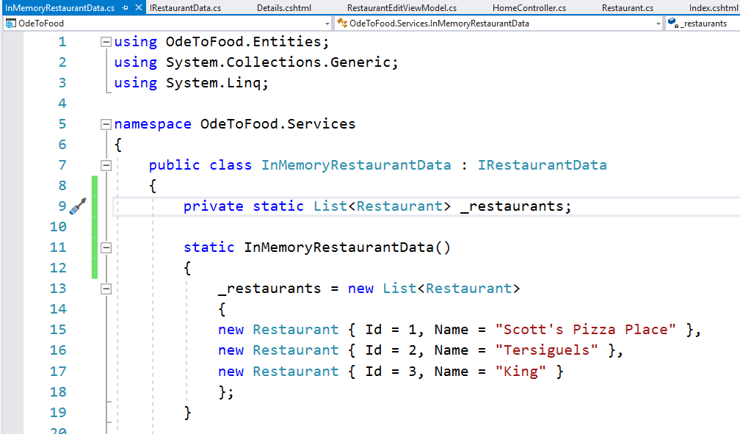
Form to Models
Notes:
Form to Models
There's one more thing we’re going to change to get this to work.
We’re going to make this list of restaurants a static member.
That means that this class is not thread safe at all.
If you ever have concurrent users working with this InMemoryRestaurantData, there's a pretty good chance it's going to explode and die.
But we do just plan on using this for testing purposes when we’re an individual developer.
The reason we’re making this static, and the reason we’re changing this into a static constructor is that we’re always working with the same list throughout the life of the application no matter what happens.
We'll always be working with the same list of restaurants. That sort of simulates a database. It just doesn't handle concurrent users. Let's save everything and refresh this form to make sure we have the latest bits.

Slide 22
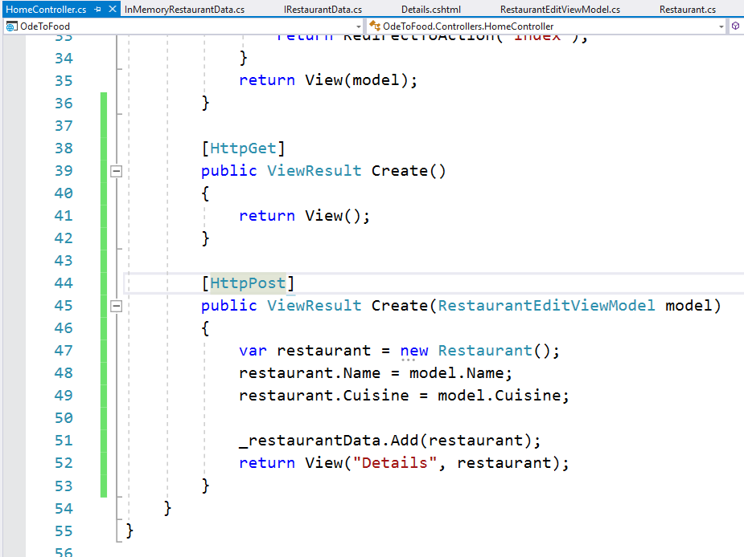
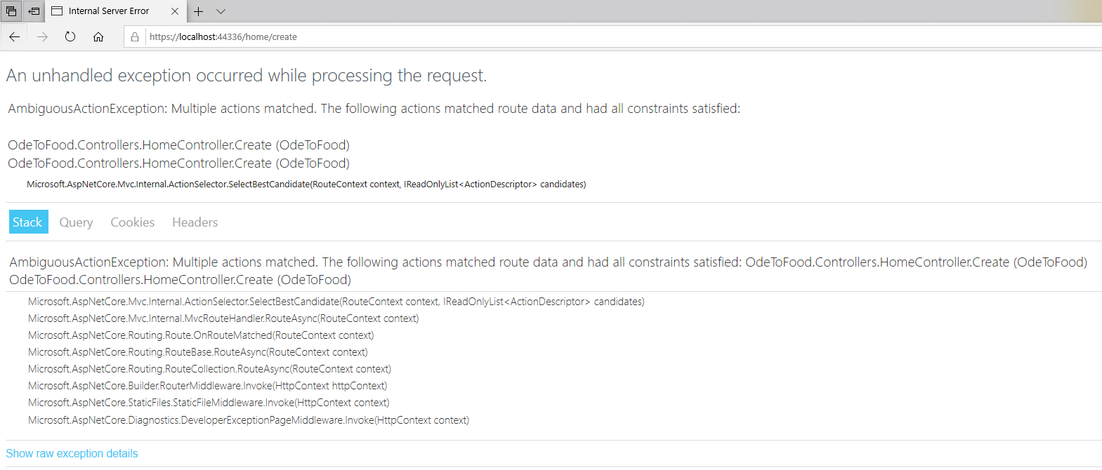
Form to Models
Notes:
Form to Models
You'll see that we run into an exception.
The exception in this case is because ASP.NET MVC sees that we’re trying to get to /home/create, but it sees two actions that match that name.
It cannot differentiate between the two. We know that the action method without parameters is supposed to give you the form for editing a restaurant, and the other one is supposed to receive the form that is editing a restaurant.
The MVC framework doesn't know that. The way we can tell the MVC framework about those intentions is to say that this action method should only respond to an HTTP GET request, and the other version of the action should only respond to an HTTP POST request.
Those are two different methods, and a GET is usually used to read information, while a POST is used to create or update information.
We only want to use a POST when we’re modifying state on a server. We do this with the [HttpGet] and [HttpPost] attributes. With those changes, let's save the controller and refresh the page.
When we enter the name of a new restaurant, we will make this an Italian restaurant, click Save, and you can see that the response from the HTTP POST version of the Create action is to show the Details view, which does show us that this restaurant does have an Id of 4 and the cuisine is Italian. That looks like everything is working. But there're a few things that we can do to improve this experience.

Slide 23
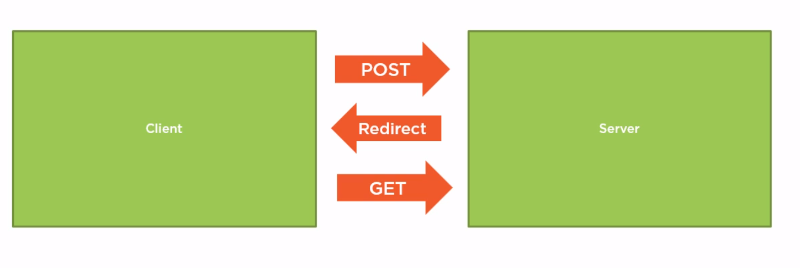
POST – REDIRECT – GET Pattern
Notes:
POST Redirect GET Pattern
At this point, we want to introduce you to or remind you of the POST-REDIRECT-GET Pattern for web applications.
Currently, our client, the browser, has a form that will use an HTTP POST method to send new restaurant data to the server.
Currently our server responds immediately with the details of the new restaurant.
Responding to a POST operation with an HTML page can cause troubles because if the user decides to refresh the browser, the browser will need to send another HTTP POST message which will try to add the restaurant to the data store again.
It is a common practice in web applications that when you have a successful POST operation, you respond to the post with an HTTP REDIRECT status code and tell the browser to send a GET request to read the new data from somewhere else.
Remember, POST is for write operations, and GET is for read operations.
By ultimately delivering a page for reading, the user can bookmark and refresh the browser at any time without trying to write new data.
Let's see how easy it is to follow this pattern in our application.

Slide 24
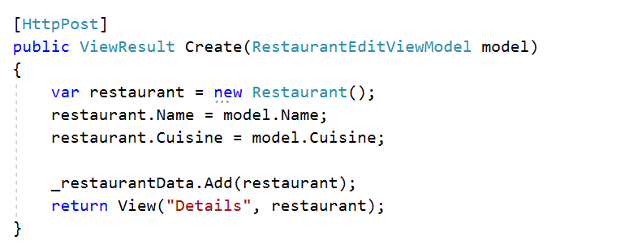
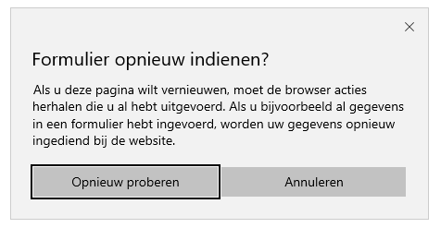
POST – REDIRECT – GET Pattern
Notes:
POST Redirect GET Pattern
Inside the browser, we are looking at the Details view that was rendered as the result of a successful POST operation, which can be dangerous.
Even the browser understands that this can be dangerous.
If we try to refresh this page, we will get a warning message that we’re about to resubmit a form, and this might cause any action that we took to be repeated.
Refreshing the results of a POST operation can lead to duplicate restaurants, duplicate transactions, charging our credit card twice, and it is generally a situation that we want to avoid.

Slide 25
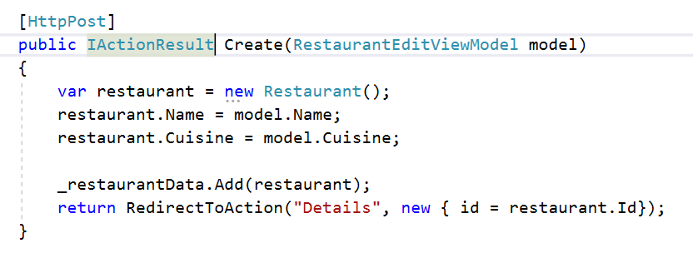
POST – REDIRECT – GET Pattern
Notes:
POST Redirect GET Pattern
Fortunately it is very easy.
Instead of responding immediately with the Details view, it would be better to send back a REDIRECT response and tell the user to go to some other URL and issue a GET request, and from there, the user can view the details of a restaurant.
This is as easy as this. Instead of returning a view, let's return a RedirectToAction result.
We want to go to the Details action. Instead of passing the restaurant along, remember this is sending a response back to the client, and we need to send a response back that will include enough information for the browser to issue a GET request to the correct Details URL, and that means it needs to include the restaurant Id.
Just like when we used the HTML helper to build an anchor tag that included the Id of a restaurant, this RedirectToAction method includes a parameter where you can pass in routeValues.
There's also overloads of this RedirectToAction method that would allow you to redirect to a completely different controller.
We want to go to the Details action on the same controller.
We need to pass along some routeValues. So, once again, we just need an object that has properties that represent the state that we want included in this redirect.
We need the Id included. We will say that the Id should be equal to the Id of the new restaurant we just created.
We can add as many properties as we want to this anonymous type. All the property values will be bundled up somewhere.
My routing rules allow for an Id parameter in the URL. So the Id can go into the URL, and we'll have something like /home/details/4.
If a parameter doesn't fit into the URL, MVC will place that parameter into the query string.
We can get as many parameters as we want, and all we need to do now is change our return type to IActionResult instead because, as we'll see, there's some more work to do inside of this method.
Let’s go back to the form where we can create a restaurant.
We'll refresh this form just so we can start with a blank form. Let’s use the name Airport Inn and choose an Italian cuisine. Click Save.
You'll notice even the URL in the browser changed. We are now at /home/details/4. Since this was a GET request, we can refresh this page as many times as we want.
There's no warning from the browser. There's no chance of trying to create that restaurant again.
And this is generally the approach you should use when you have a successful POST operation.
What if the POST operation is not successful?
What if the user didn't send correct information to create a new restaurant?
And how could we even check to see if all the information we need is there?

Slide 26
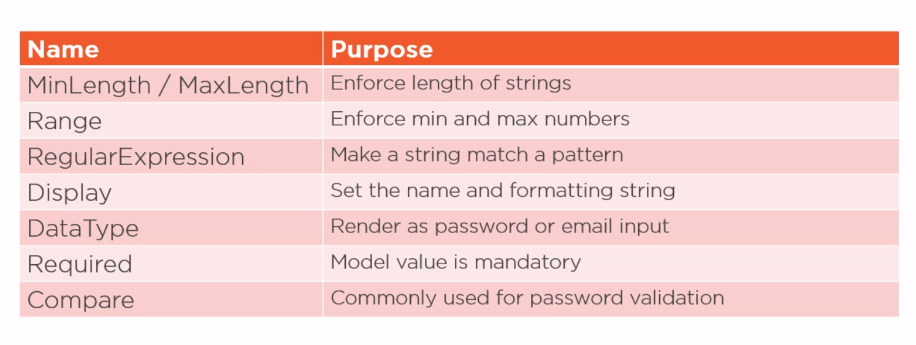
Data Annotations for Models
Notes:
Data Annotations for Models
When the user creates a new restaurant, there are some rules we want to apply to the data that they gives us.
For instance, we want the restaurant name to be a required field.
One of the easiest techniques for enforcing rules like this is to use data annotations that are available in .NET.
Annotations are annotations like MinLength and MaxLength, which require a string input to be a certain minimum or maximum size.
We can also check the range of a number, match a string against a regular expression, or compare two model values using the Compare annotation.
Some data annotations also influence the display of a model value or the label for a model value.
These are annotations like Display and DataType.
If we tell the MVC framework that a given model value will hold an email address, the HTML helper we use to render the input will render an input element where the type attribute is set to email.
On some devices, this will give the user a different type of input or a different keyboard to enter the values into that input.
Let's add some annotations in our project.
Let's add some annotations and enforce model validation in our project.

Slide 27
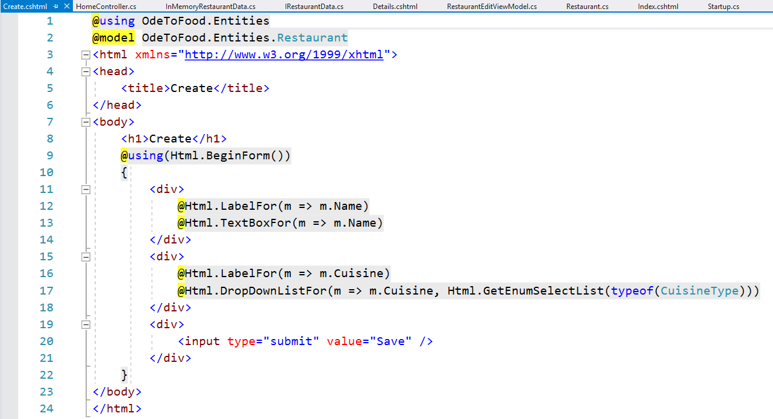
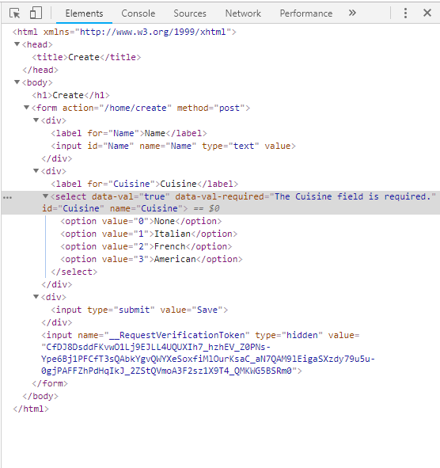
Data Annotations for Models
Notes:
Data Annotations for Models
To see how we can use data annotations, let's first go back to the view that we used to create a restaurant.
We start with an empty form and want to inspect the HTML that is on this page.
The first thing we will call your attention to is the label.
The label is telling the user that this is where they input the name of a restaurant.
That comes from our Create view that's using an HTML helper LabelFor.
Remember, LabelFor works against the model type. It retrieves information about the model and specifically about the property that we identify and uses that information to create the output.
The model that we are using in the Create view is our Restaurant entity. If we want to influence what LabelFor is doing, we need to add our data annotations to this Restaurant Entity.
Right now when we say we want a label for the Name property, really the only information that LabelFor has to work with is the name of this property, which is Name, and its type, which is string.
The whole idea behind data annotations is that we can add additional metadata that HTML helpers can use to build the HTML.

Slide 28



Data Annotations for Models
Notes:
Data Annotations for Models
So what is a data annotation?
Well, for starters, most data annotations are in the System.ComponentModel.DataAnnotations namespace.
This namespace contains more than a dozen attributes that we can apply to models and model properties to provide additional metadata.
For example, there is a Display annotation and a DisplayFormat annotation.
DisplayFormat is something where we can pass along a formatting string.
That's very helpful when we’re working with numeric types or DateTimes because we can tell these HTML helpers how to format that particular value in a specific way.
Do we want digits after the decimal? Or for DateTime, do we want to display just the month or the year or just the time information?
In the Display attribute, we can set properties like the actual name to use in the UI when you refer to this property.
We could say this should be “Restaurant Name”. You will see instead of just displaying Name, we display Restaurant Name.
By default, a lot of these HTML helpers will just try to derive some piece of the UI from the property name, but we don't always have C# properties that map well to make a pleasant user interface.
We don't put spaces in property names, and we don't use punctuation. We can do that with the Display annotation. Some of the data annotations are all about presenting things on the screen.

Slide 29

Data Annotations for Models
Notes:
Data Annotations for Models
Other annotations are used to enforce validation.
These are annotations like [Required] saying that Name is a required field.
You can inside of the square brackets include multiple annotations if you want. Or you could put each annotation on a separate line. It really depends on your sense of style.
Let's say that a restaurant name is required, that's its MaxLength is 80 characters, and let me show you one more attribute.
We’re going to say temporarily that the DataType is DataType.Password. Notice there's a number of different DataTypes to choose from. These for the most part really just influence the type of input that is rendered.
For instance, if we say this DataType.EmailAddress, we can have an HTML helper that renders an input type = email.

Slide 30



Data Annotations for Models
Notes:
Data Annotations for Models
Let's temporarily choose Password.
In order for this to work, we do need to make one more change in the view.
When we use the HTML helper TextBoxFor, we’re explicitly telling the framework we want an input type = text.
In that case, our HTML helper is going to ignore some of the data annotations that we have placed on that property.
There's a more generic HTML helper called EditorFor, which uses pretty much the exact same syntax.
But now what I'm asking the framework is, give me the best editor based on the information you have available.
I'm not forcing you to use input type = text. You choose what is best.
And now if I save my Create view, save all the files, and refresh my form, I'm going to see that my input has changed dramatically.
For right now, I just want to call your attention to the type.
The type is password.
That means if I type in here, the browser knows now to display the characters that I'm typing into that input, which isn't what we want for the restaurant name.
So I'm going to remove that particular data annotation.

Slide 31


Data Annotations for Models
Notes:
Model Validation with Data Annotations
You'll notice there're a lot of other attributes in our input.
Some of these attributes seem to be implying that the maximum length of this input is 80 characters.
These particular attributes, like data-val-maxlength-max, are used to enforce client validation rules.
We're not using the built-in HTML5 attributes. What we will need to do to enforce client-side validation is add some JavaScript libraries to the page, some JavaScript libraries that will detect these attributes and enforce these rules (we'll come to that later in this course) because it doesn't matter if we have client-side validation, we also need to have server-side validation.
That's the most important piece because anyone can circumvent client-side validation, so how can we make sure that when the user saves this form, the restaurant name is populated?
That's when we have to think not about the model that was used to create this view, but about the model that receives information from this view because inside of a controller action, we can ask the MVC framework if a particular view model or model or input model, whatever you want to call it, if it is valid or not.
So these data annotations, not only can they help you generate HTML in the view, but they can also be used to enforce some validation rules when you are inside of a controller action that's receiving model data.
Anytime you have a parameter to an action method, think of that parameter as a model, and the MVC framework does something it calls model binding to move information from the request into that model.
Then the framework will also run any validation rules that the data annotations specify.
Let’s try this. We want to come back to our restaurant, and we’re going to remove DataType.Password.
We are going to copy the Required and MaxLength attributes and save restaurant.
We will open up RestaurantEditViewModel.
Here on the name attribute, we will add Required and MaxLength and also make sure to bring in the correct namespace for these data annotations.

Slide 32



Data Annotations for Models
Notes:
Model Validation with Data Annotations
All we need to do inside of a controller action method is before we go about saving this new restaurant information, we want to check if this model is valid.
When you derive from the base controller class in MVC, your controller will have a property that you inherit called ModelState.
This property, which is a ModelState dictionary, gives you the ability to add new model errors.
Perhaps you want to write some validation code right here in the action method.
You can also poke around inside of ModelState and look at specific fields that you've received from the user to see if they're valid or what error message is associated with the particular property.
Commonly what we always need to do is just check the IsValid property.
So if ModelState is valid, then we know that our model has passed the validation rules.
If it has passed all our validation rules, only then do we want to save the new restaurant and then try to redirect the user back to see the details of the restaurant.
Otherwise, what should we do?
Well if the user has given us invalid data, we typically just want to re-render the form so that the user can try again.
But we will also want to display error messages to the user so they know what they did wrong.
The error messages we can add with some additional HTML helpers.
Typically for every editor, you have a Label, an Editor, and then a ValidationMessage that is associated with that particular model property.
This is telling the MVC framework if there're any validation messages that were generated for the Name property, show them inside the div.
We should also add that ValidationMessage for the cuisine in case something went wrong with that.
There's also an HTML helper ValidationSummary that you can use to group all the error messages if you want into a single location.
With this UI, we will display the validation messages right alongside the input.
Let's save everything, come back to our browser.
Let's refresh this form to get a fresh form and try to save a restaurant with no name.
What our controller has done is it has detected that ModelState is not valid.
It has re-rendered this view so that the user is again presented with the form information.
But this time, there've been some validation messages associated with some of the inputs. We are displaying them too. And hopefully this gives you an idea of how data annotations, HTML helpers, and ModelState can all work together.
You can use the built-in data annotations.
You can also implement custom data annotations.
And that's one way to automatically enforce some validation rules on your model objects.
It's also a way to influence the display of the values that are in your model objects.
Then inside of the controller actions that receive the information from a form, you always want to check if ModelState is valid before you accept that input and try to save it somewhere.

